Slide 1
ML Assignment -2
Team members:
R.HEMA 23WU0102165
N.NAINA VISMI 23WU0102137
N.HYNDHAVA MAHESH 23WU0102140
N.ABHIRAM RUSHI 23WU0102136
M.HARSHITH 23WU0102119
- Dr. Amit Swamy

Slide 2
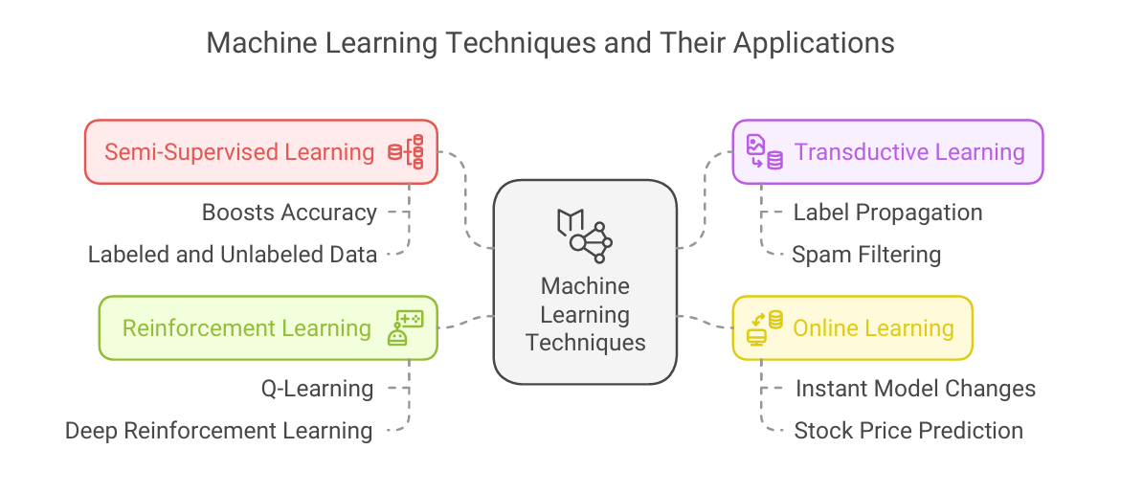
Task - 1
Problem Statement:
Develop a Q-Learning agent to navigate a 4x4 Grid World and reach the goal at position (3,3) while learning an optimal policy. The agent will explore the environment, update Q-values, and improve decision-making over time?
Input Information:
1. Environment
- Grid: 4x4
- Actions: Up, Down, Left, Right
- Goal: (3, 3) (Reward = 1)
2. Parameters
- Learning Rate (alpha): 0.1
- Discount (gamma): 0.9
- Exploration (epsilon): 0.1
Output:
Example Q-values at state (3, 2):
[0.0, 0.9, 0.0, 1.0]
Meaning: Highest value (1.0) suggests moving right (action 3).
APA References:
Academic Papers & Books
Watkins, C. J. C. H., & Dayan, P. (1992). Q-learning. Machine Learning, 8(3-4), 279-292.

Slide 3
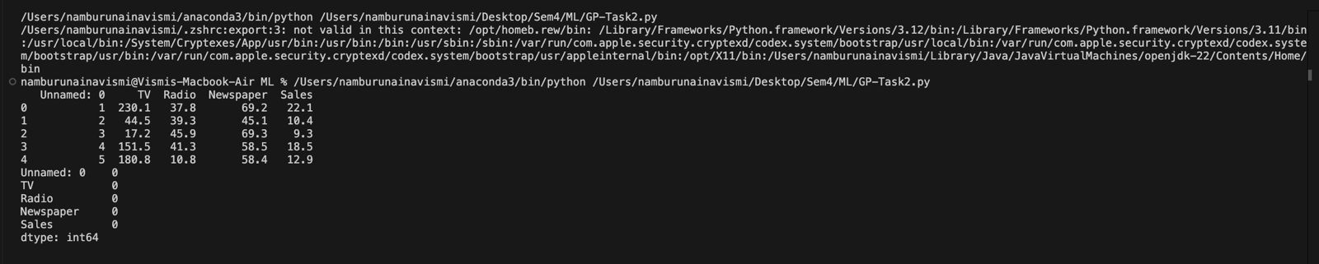
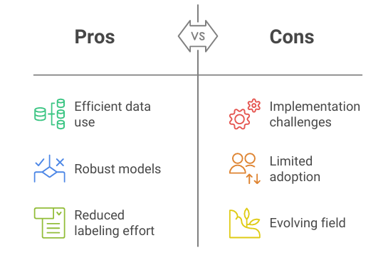
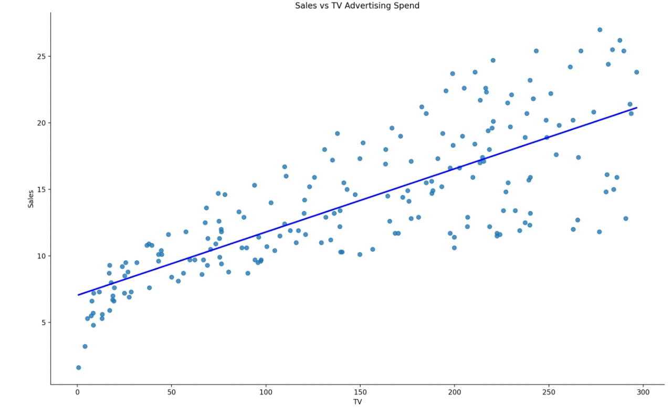
OUTPUT:
Task - 2

Slide 4
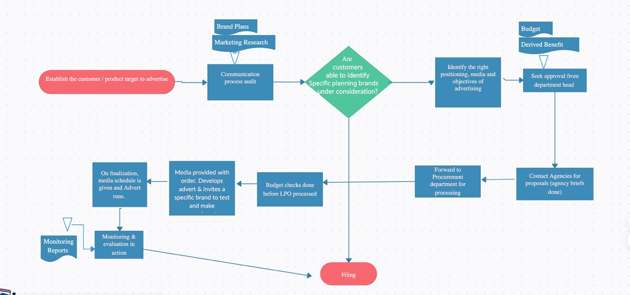
FLOW CHART:

Slide 5
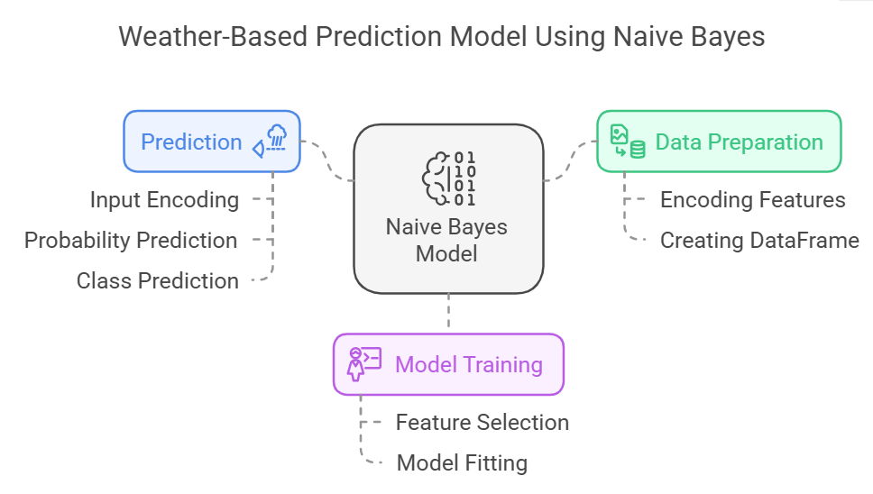
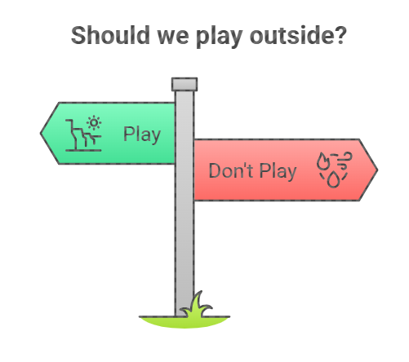
TASK - 3
RESULT:

Slide 6
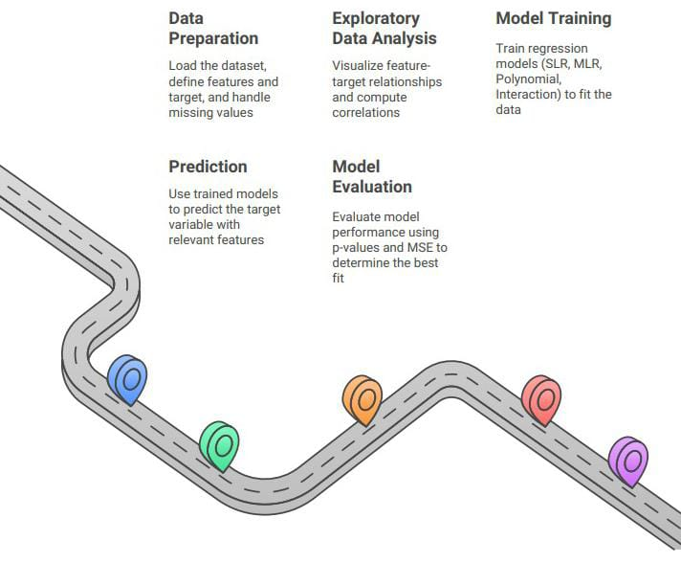
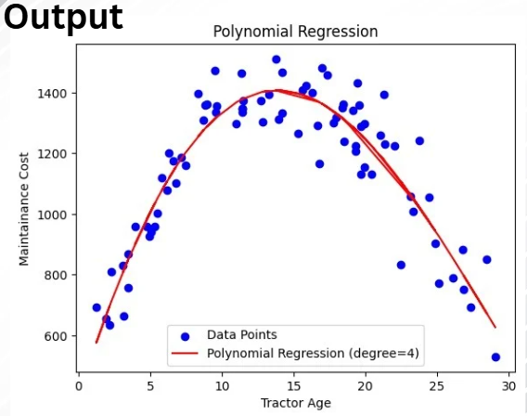
TASK - 4

Slide 7

Thank you

